Slide 1
Introduction to BERT

Slide 2

Transformer Based Models
OpenAI’s GPT

Slide 3

Transformer Based Models
OpenAI’s GPT
Google’s BERT

Slide 4

Transformer Based Models
OpenAI’s GPT
Google’s BERT
OpenAI’s GPT-2

Slide 5

Transformer Based Models
Transformer-XL
(Jan, 2019)

Slide 6
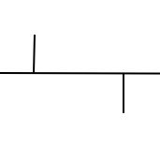
Transformer Based Models
Transformer-XL
(Jan, 2019)
(Jun, 2019)
XLNet

Slide 7
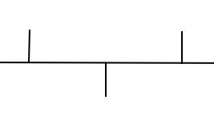
Transformer Based Models
Transformer-XL
(Jan, 2019)
RoBERTa
(Jul, 2019)
(Jun, 2019)
XLNet

Slide 8
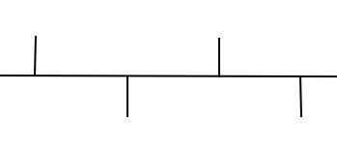
Transformer Based Models
Transformer-XL
(Jan, 2019)
RoBERTa
(Jul, 2019)
(Jun, 2019)
XLNet
(Sep, 2019)
CTRL

Slide 9
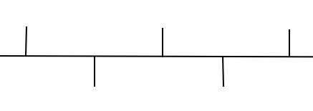
Transformer Based Models
Transformer-XL
(Jan, 2019)
RoBERTa
(Jul, 2019)
ALBERT
(Dec, 2019)
(Jun, 2019)
XLNet
(Sep, 2019)
CTRL

Slide 10
BERT
BERT - Bidirectional Encoder Representations from Transformers

Slide 11
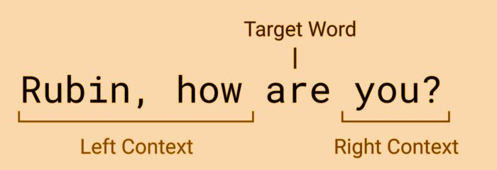
BERT
BERT - Bidirectional Encoder Representations from Transformers

Slide 12
BERT
BERT - Bidirectional Encoder Representations from Transformers

Slide 13
BERT
BERT - Bidirectional Encoder Representations from Transformers
BERT is pre-trained on a large corpus of unlabelled text
Wikipedia(that’s 2,500 million words)
Book Corpus (800 million words)

Slide 14
BERT
BERT - Bidirectional Encoder Representations from Transformers
BERT is pre-trained on a large corpus of unlabelled text
Wikipedia(that’s 2,500 million words!)
Book Corpus (800 million words)
BERT Models:
BERT-base (12 Encoder Stack)
BERT-base (24 Encoder Stack)

Slide 15
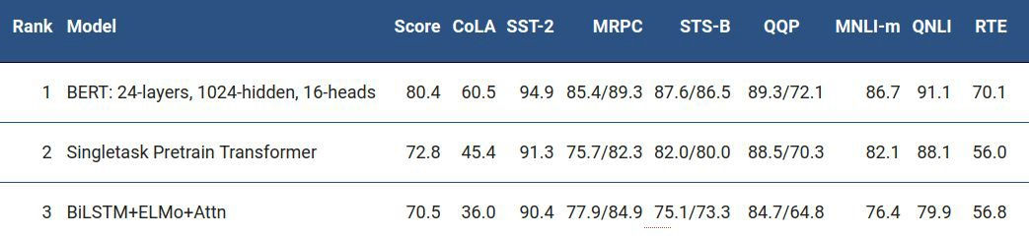
Performance of BERT
GLUE (General Language Understanding Evaluation) Benchmark
It is a collection of datasets used for training, evaluating, and analyzing NLP models relative to one another

Slide 16
Applications of BERT
Generate Text Embeddings

Slide 17
Applications of BERT
Generate Text Embeddings
Text Classiﬁcation

Slide 18
Applications of BERT
Generate Text Embeddings
Text Classiﬁcation
Named Entity Recognition

Slide 19
Applications of BERT
Generate Text Embeddings
Text Classiﬁcation
Named Entity Recognition
Question & Answering

Slide 20
Thank You

